Slide 1

GRAPH THEORY AND ITS APPLICATIONS
Dr. Arti Arya
Department of Computer Science & Engineering

Slide 2
GRAPH THEORY AND ITS APPLICATIONS
Graph Applications
Dr. Arti Arya
Department of Computer Science & Engineering

Slide 3
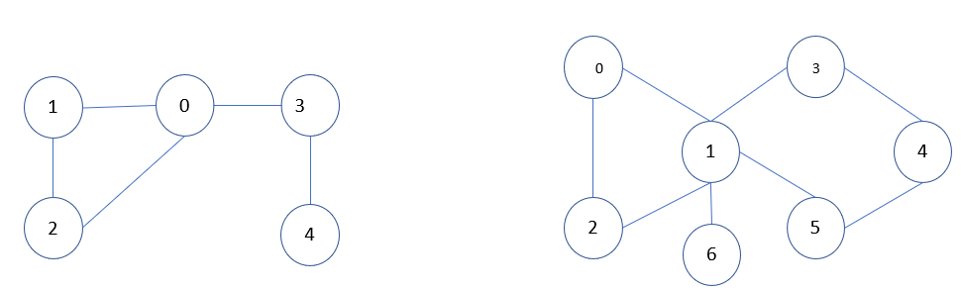
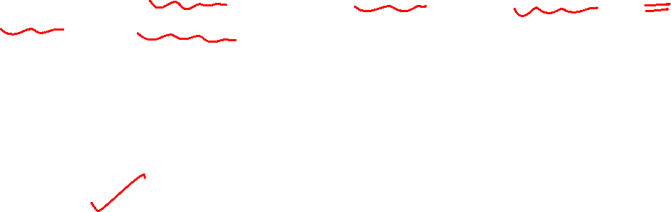
Graph Theory and its Applications
Articulation Points
Articulation Points and Reliable Communication Networks
A vertex in an undirected graph is an articulation point or cut vertex iff removing it disconnects the graph.
Articulation point represents vulnerabilities in a connected network - single points whose failure would split the network into two or more components.
They are useful in designing reliable networks.

Slide 4
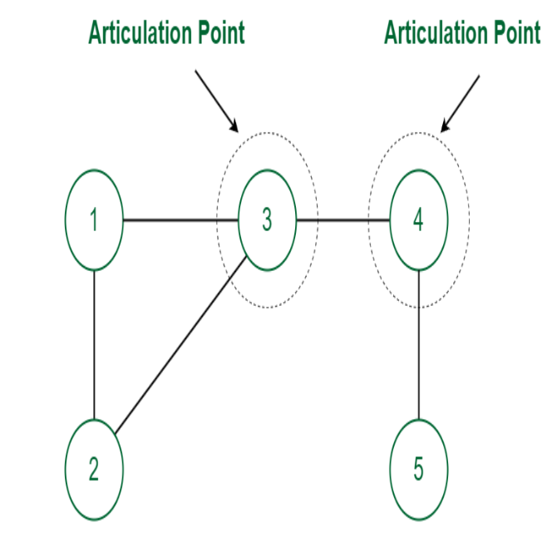
Graph Theory and its Applications
Articulation Points

Slide 5
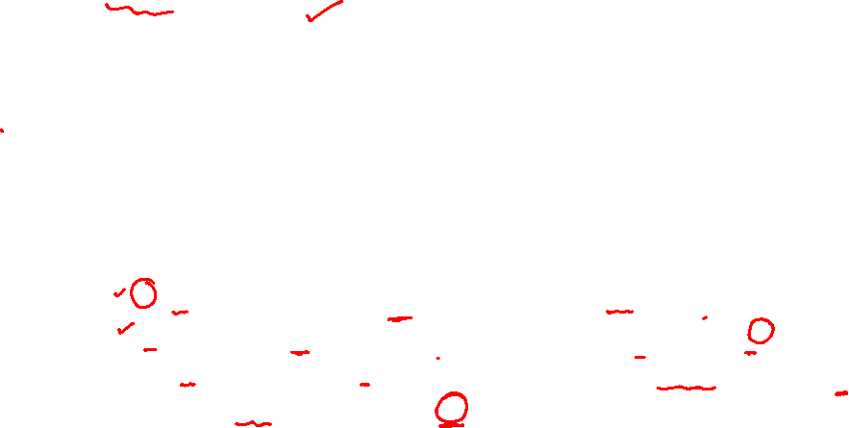

Graph Theory and its Applications Articulation Points
Tarjan’s Algorithm
The idea is to use DFS (Depth First Search).
In DFS, follow vertices in a tree form called the DFS tree. In the DFS tree, a vertex u is the parent of another vertex v, if v is discovered by u.
In DFS tree, a vertex u is an articulation point if one of the following two conditions is true.
u is the root of the DFS tree and it has at least two children.
u is not the root of the DFS tree and it has a child v such that no vertex in the subtree rooted with v has a back edge to one of the ancestors in DFS tree of u.

Slide 6
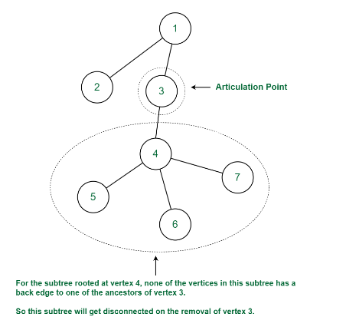
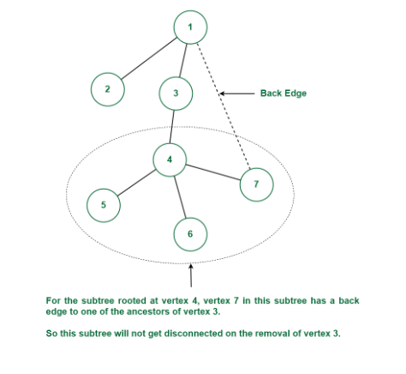
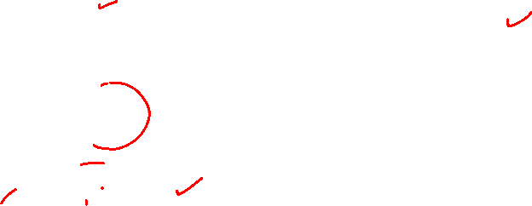
Graph Theory and its Applications Articulation Points
Tarjan’s Algorithm
Articulation Points (or Cut Vertices) in a Graph - GeeksforGeeks

Slide 7
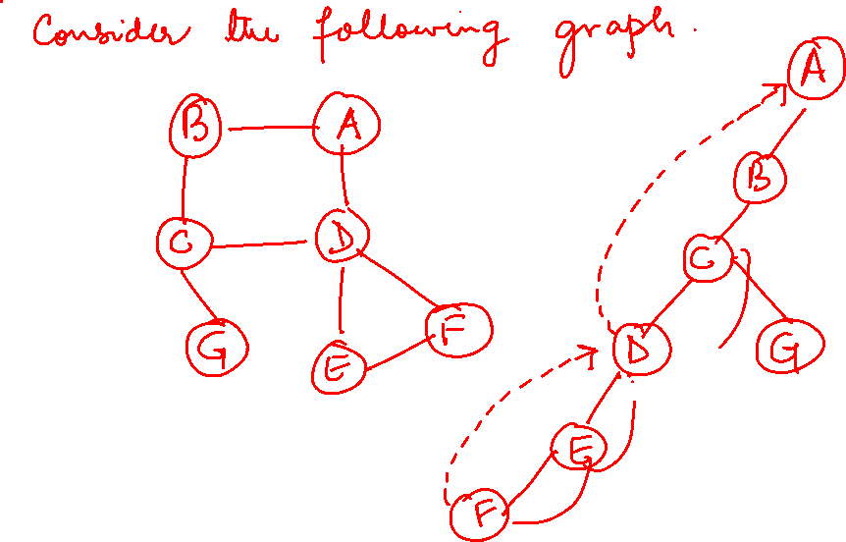
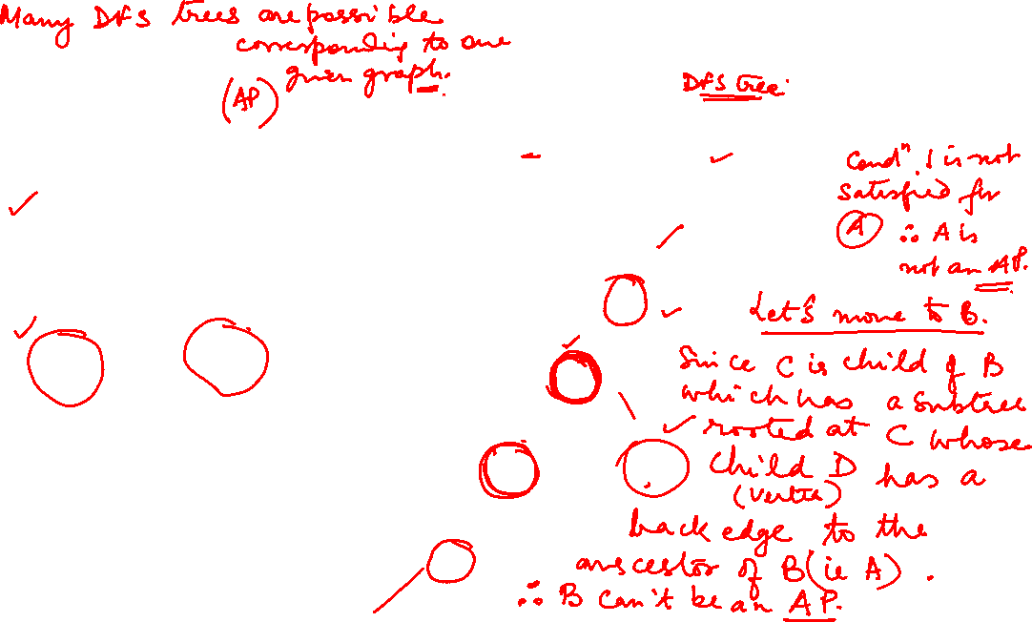
Find the articulation Points
1

Slide 8
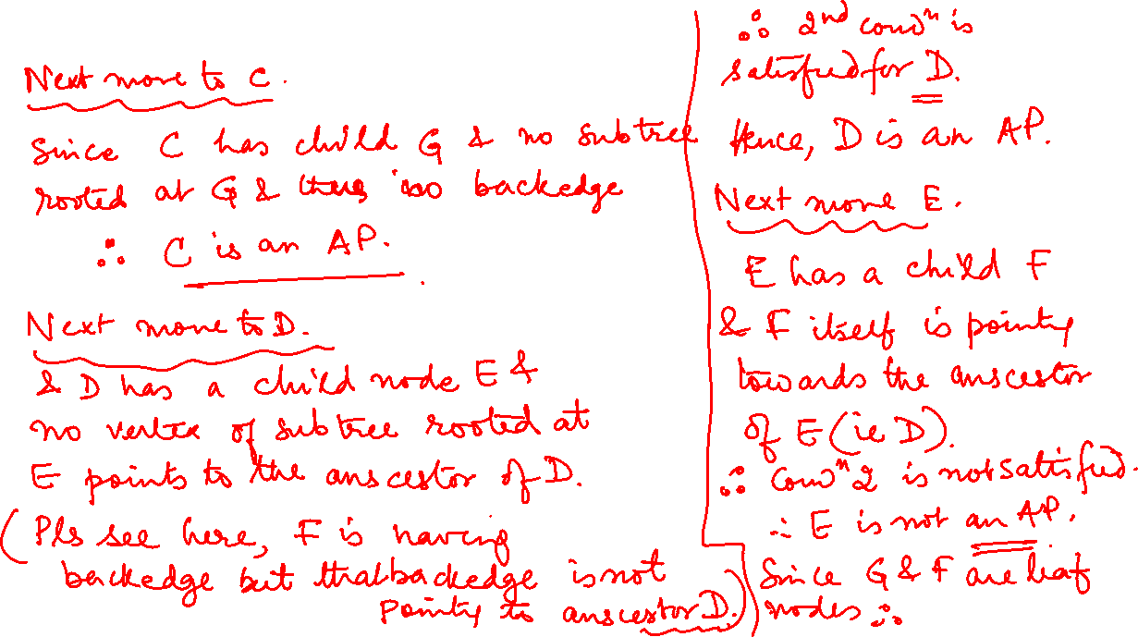

Slide 9
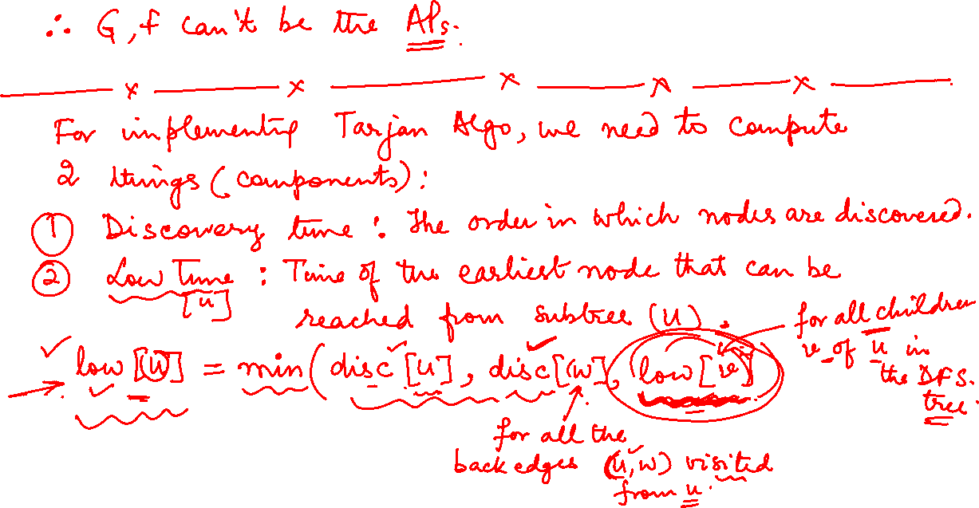


Slide 10
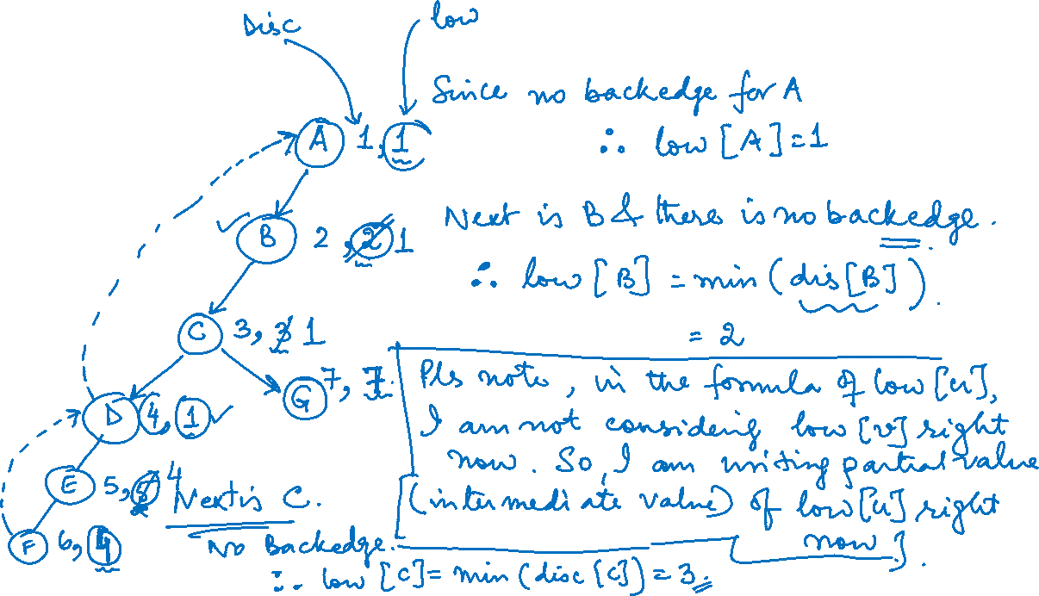

Slide 11
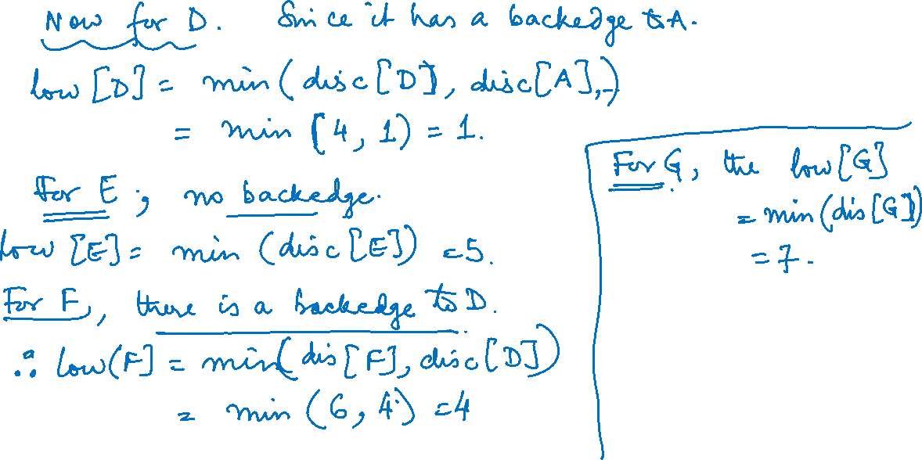

Slide 12
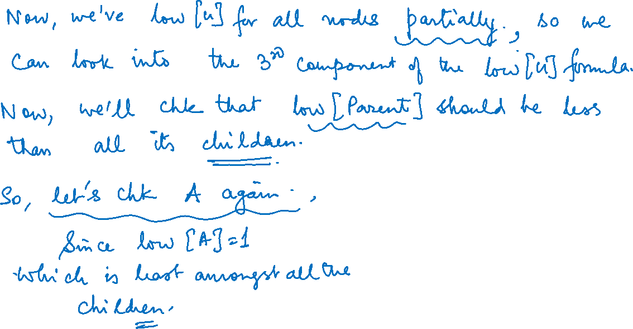

Slide 13
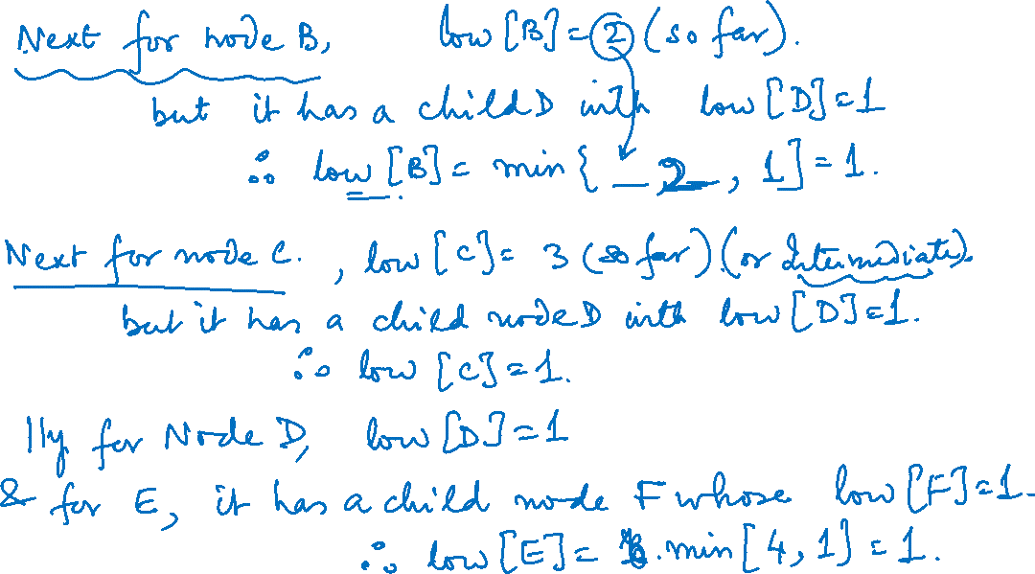

Slide 14
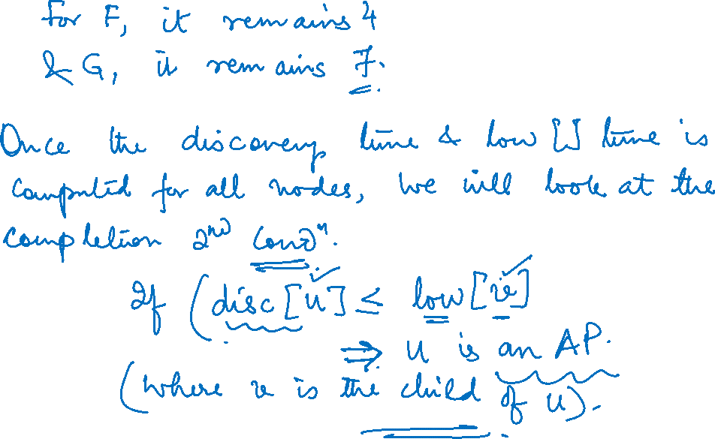
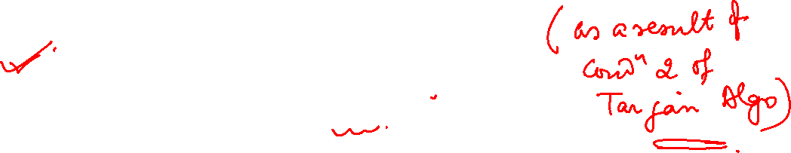

Slide 15
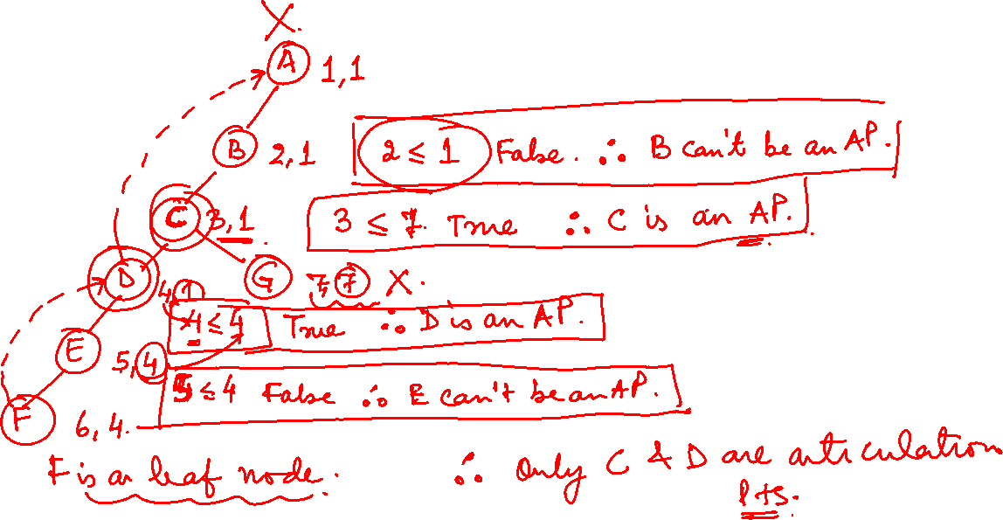

Slide 16
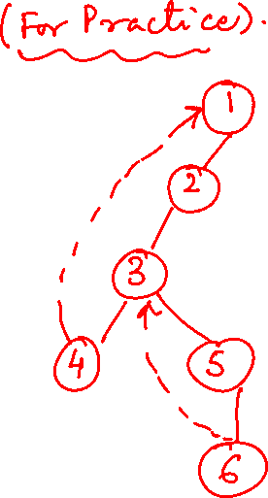
Graph Theory and its Applications Articulation Points
Find the articulation Points
1
4
2
3
5
6

Slide 17
Graph Theory and its Applications Articulation Points
Find the articulation Points
a
g
b
c
d
h
e
f

Slide 18
THANK YOU
Dr. Arti Arya
Department of Computer Science &Engineering
artiarya@pes.edu

